Slide 1

3G check
On-site class [GI Lecture]
ventilation break
Hybrid mode
Webex Session
10.00
10.15
11.45
12.00

Slide 2
ventilation break
On-site class [GI Lecture]
ventilation break
Hybrid mode
(no Webex Session)
14.00
14.15
15.45
16.00

Slide 3
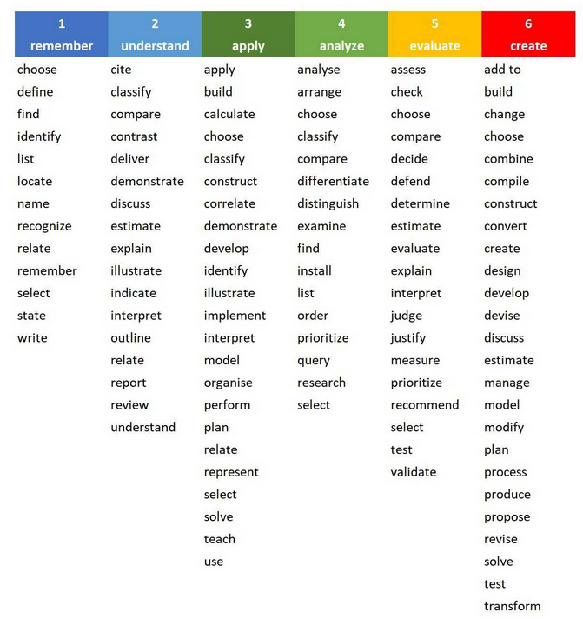
EO4GEO Version Bloom’s Revised Taxonomy
summarize

Slide 4
Lifelong learning
A4 & A5 Conference paper & presentation
Compile final paper and prepare for short presentation
A3 Methods & references
This ‘Scientific Writing’ course
Reflect on methods used, summarize main ideas, document sources
A2 Scientific essay
Get more specific on your topic or subject of interest, search for references
A1 Free essay
General, associative …
no references, opinion building

Slide 5
… a gift
… an art
Writing
… a kind of craftsmanship

Slide 6
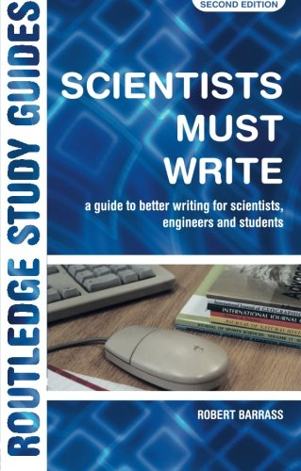
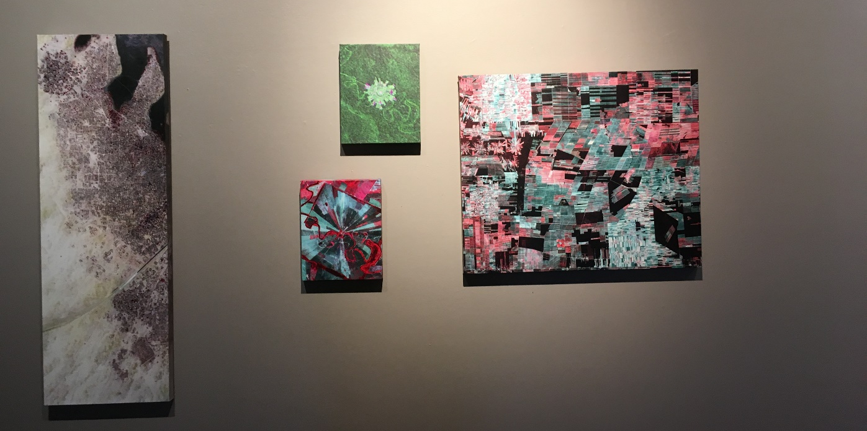

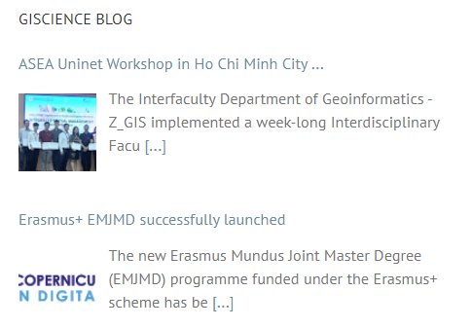
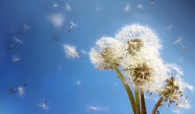

Slide 7


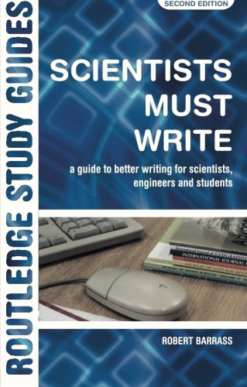
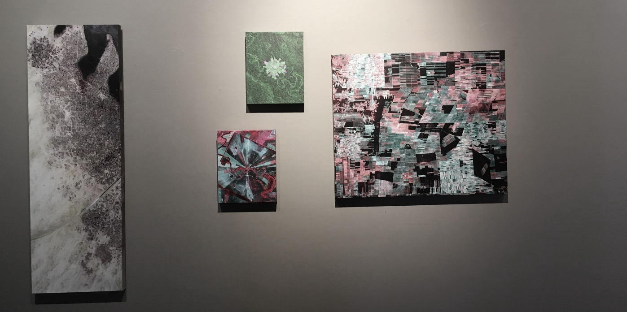

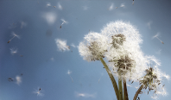

Slide 8
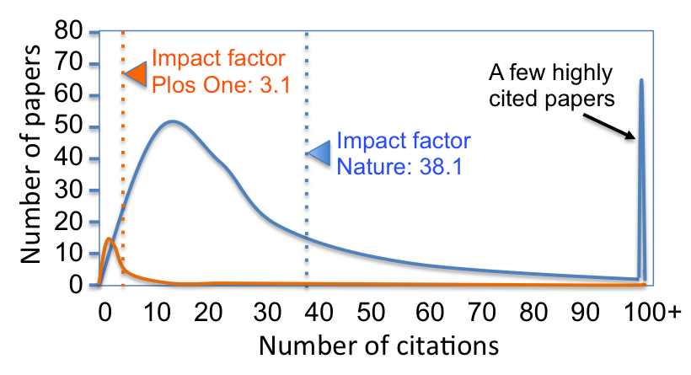



Slide 9
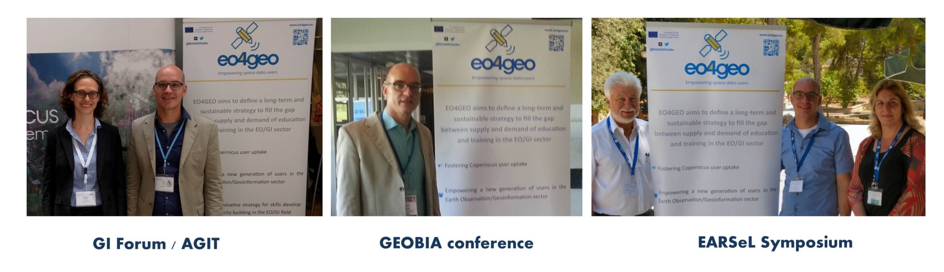

Slide 10
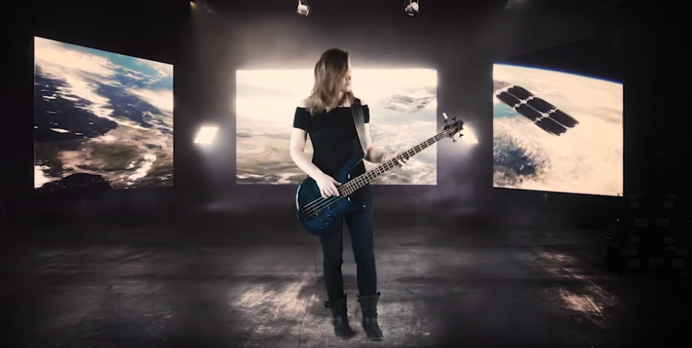
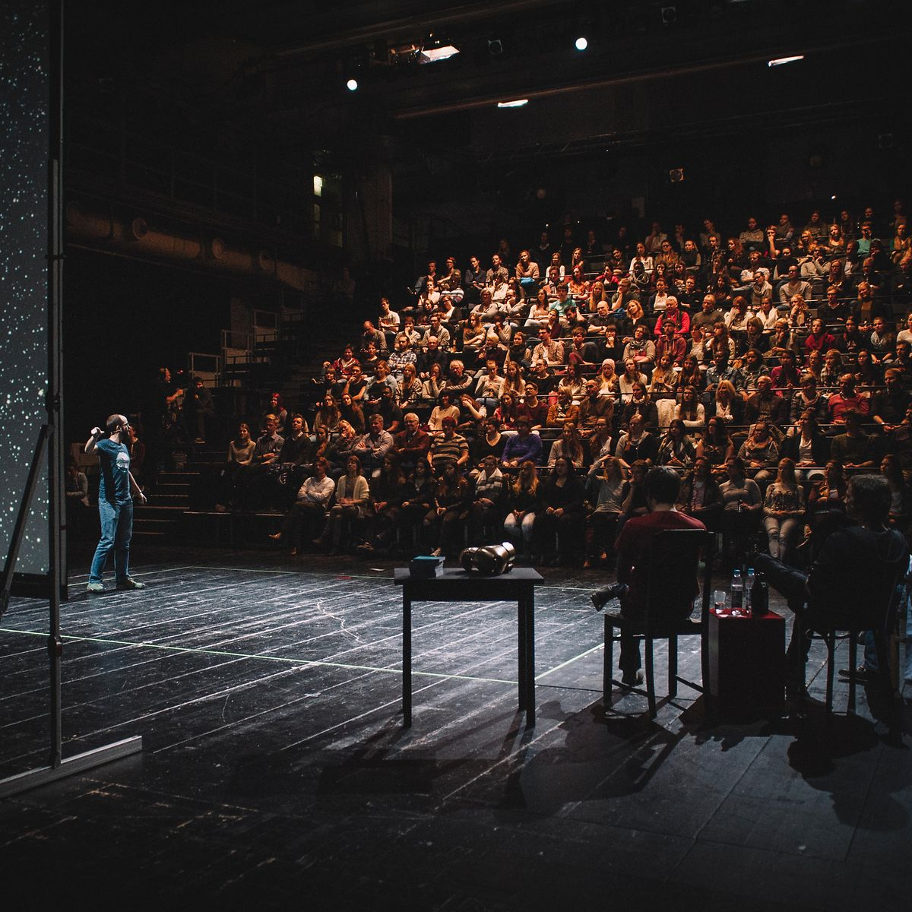


Slide 11

